Slide 1


ROAD ACCIDENT REPORT
PRESENTED BY
VAISHNAVI BHUJBAL.

Slide 2
AGENDA OF REPORT
INTRODUCTION
OBJECTIVE
ANALYSIS OF VISUAL
INSIGHTS
KEY BUSINESS QUESTIONS ANSWERED
CONCLUSION

Slide 3
Introduction
Road accidents are a critical concern worldwide, leading to substantial loss of life, injuries, and economic costs. Understanding the factors contributing to accidents and their severity is essential for formulating effective safety measures and policies. This project explores a comprehensive Road Accident Dashboard, designed to provide insights into key accident metrics such as total accidents, casualties, and their severity, while analyzing contributing factors such as vehicle type, road conditions, and weather.
The dashboard utilizes real-time filtering to focus on specific accident severity levels (e.g., Serious, Fatal, or Slight casualties), allowing targeted analysis of different datasets. By leveraging interactive visualizations like line charts, pie charts, bar charts, and geographical heatmaps, it enables stakeholders to:
Identify trends in accidents and casualties.
Pinpoint high-risk vehicle types and road conditions.
Assess the impact of weather and road surfaces on accident severity.
Recognize regions with the highest accident concentrations for targeted interventions.

Slide 4
Objective
primary objective of this project is to analyze and interpret the data presented in the Road Accident Dashboard to gain actionable insights into the causes and patterns of road accidents. The key goals are as follows:
Understand Accident Trends: Identify yearly and monthly trends in road accidents and casualties to determine peak periods of risk.
Analyze Casualty Severity: Examine the distribution of fatal, serious, and slight casualties to assess the severity and its contributing factors.
Identify High-Risk Factors:
Determine which vehicle types contribute most to serious casualties.
Understand how weather, road conditions, and road types influence accident severity.
Geographical Analysis: Pinpoint accident-prone locations and regions with higher casualty rates to help prioritize safety measures.
Evaluate Year-Over-Year (YoY) Changes: Assess YoY trends to measure improvements or declines in road safety.
Provide Data-Driven Recommendations: Use the insights to propose strategies for reducing accidents and minimizing casualties.
This analysis will serve as a foundation for developing targeted interventions to improve road safety and optimize resource allocation for traffic management and infrastructure development.

Slide 5
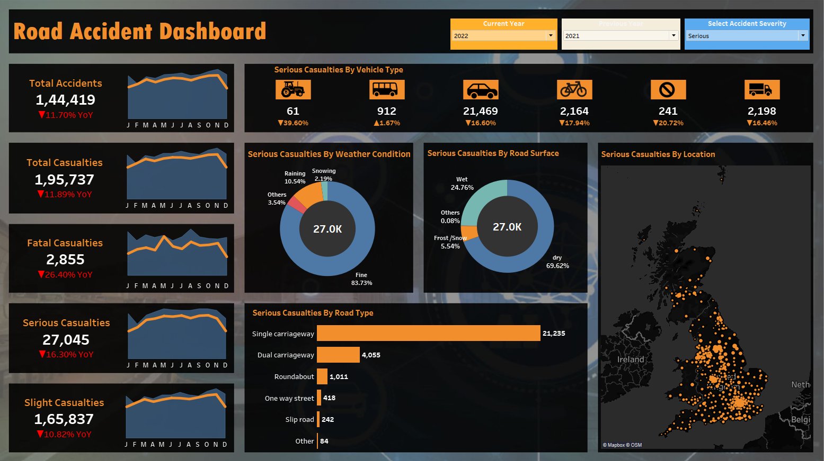
COMPLETE DASHBOARD
ROAD ACCIDENT

Slide 6
ROAD ACCIDENT REPORT

Slide 7
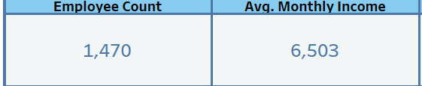
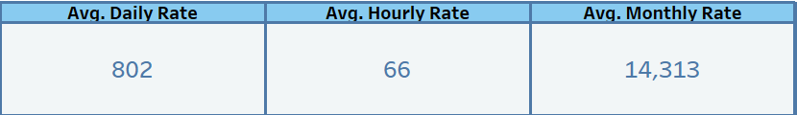
Employee Count: 1,470 employees.
Average Monthly Income: $6,503.
Average Daily Rate: $802.
Average Hourly Rate: $66.
Average Monthly Rate: $14,313.
Purpose: Provides a snapshot of overall employee compensation and workforce size.
Questions Answered:
What is the average cost per employee?
Are compensation levels competitive across roles
and departments?

Slide 8
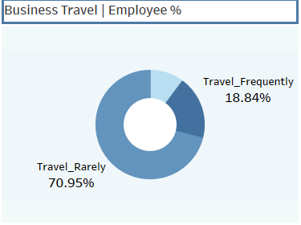
Business Travel & Employee %
Shows: Travel frequency among employees (e.g., 70.95% travel rarely).
Purpose: Understands travel demands and their potential impact on work-life balance.
Key Insight: Most employees travel rarely, reducing the likelihood of travel-related burnout.

Slide 9
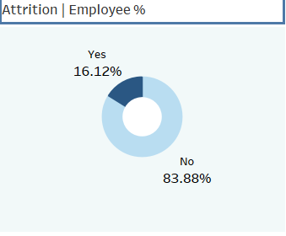
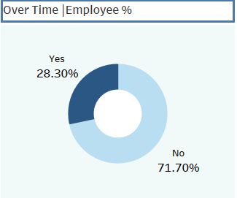
ATTRITION & OVER-TIME %
Shows: Attrition (16.12%) and employees working overtime (28.3%).
Purpose: Links overtime and attrition trends.
Key Insight: High overtime percentages could contribute to attrition

Slide 10
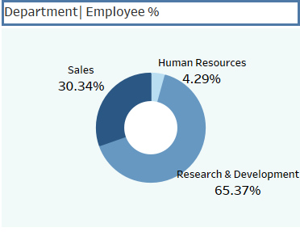
DEPARTMENT DISTRIBUTION
Shows: Employee percentage by department (e.g., R&D: 65.37%).
Purpose: Evaluates workforce distribution across departments.
Key Insight: R&D dominates the workforce; HR has the lowest representation.

Slide 11
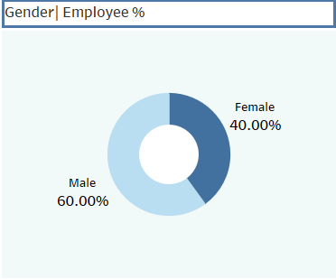
GENDER DISTRIBUTION
Shows: Workforce divided by gender (e.g., 60% male, 40% female).
Purpose: Assesses gender diversity.
Key Insight: Moderate gender disparity exists.

Slide 12
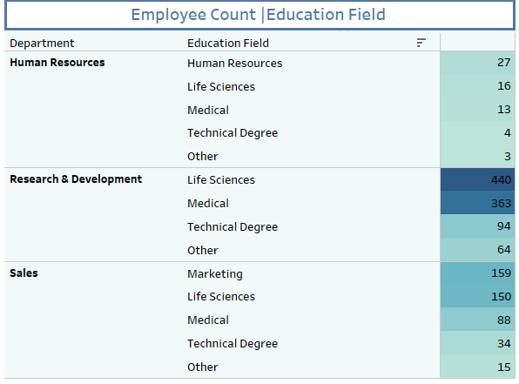
EDUCATION FIELD | EMPLOYEE COUNT
Shows: Distribution of employees by department and educational background (e.g., 440 R&D employees have Life Sciences degrees).
Purpose: Identifies how education fields align with department requirements.
Why Heat Map:
Highlights patterns and clusters in large datasets.
4. Questions Answered:
Are the right educational backgrounds allocated to the right
departments?
Is there diversity in educational qualifications within
departments?

Slide 13
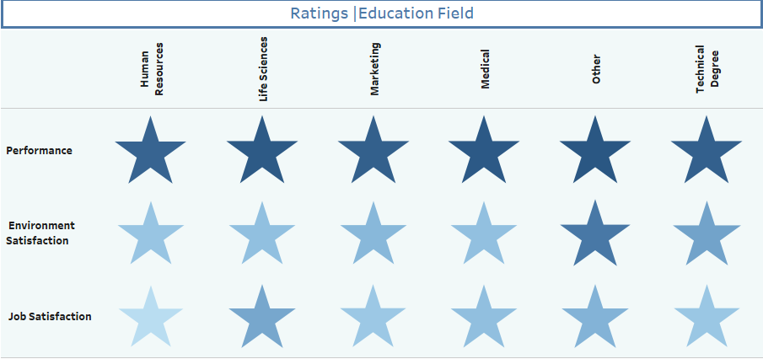
RATINGD | EDUCATION FIELDS
Shows: Employee ratings (e.g., performance, satisfaction) grouped by education field.
Purpose: Highlights variations in satisfaction and performance by educational background.
Why Star Chart:
Efficiently compares multiple attributes across
categories.
Questions Answered:
Which education fields yield higher satisfaction or
performance?
Are there disparities in satisfaction among different
education backgrounds?

Slide 14
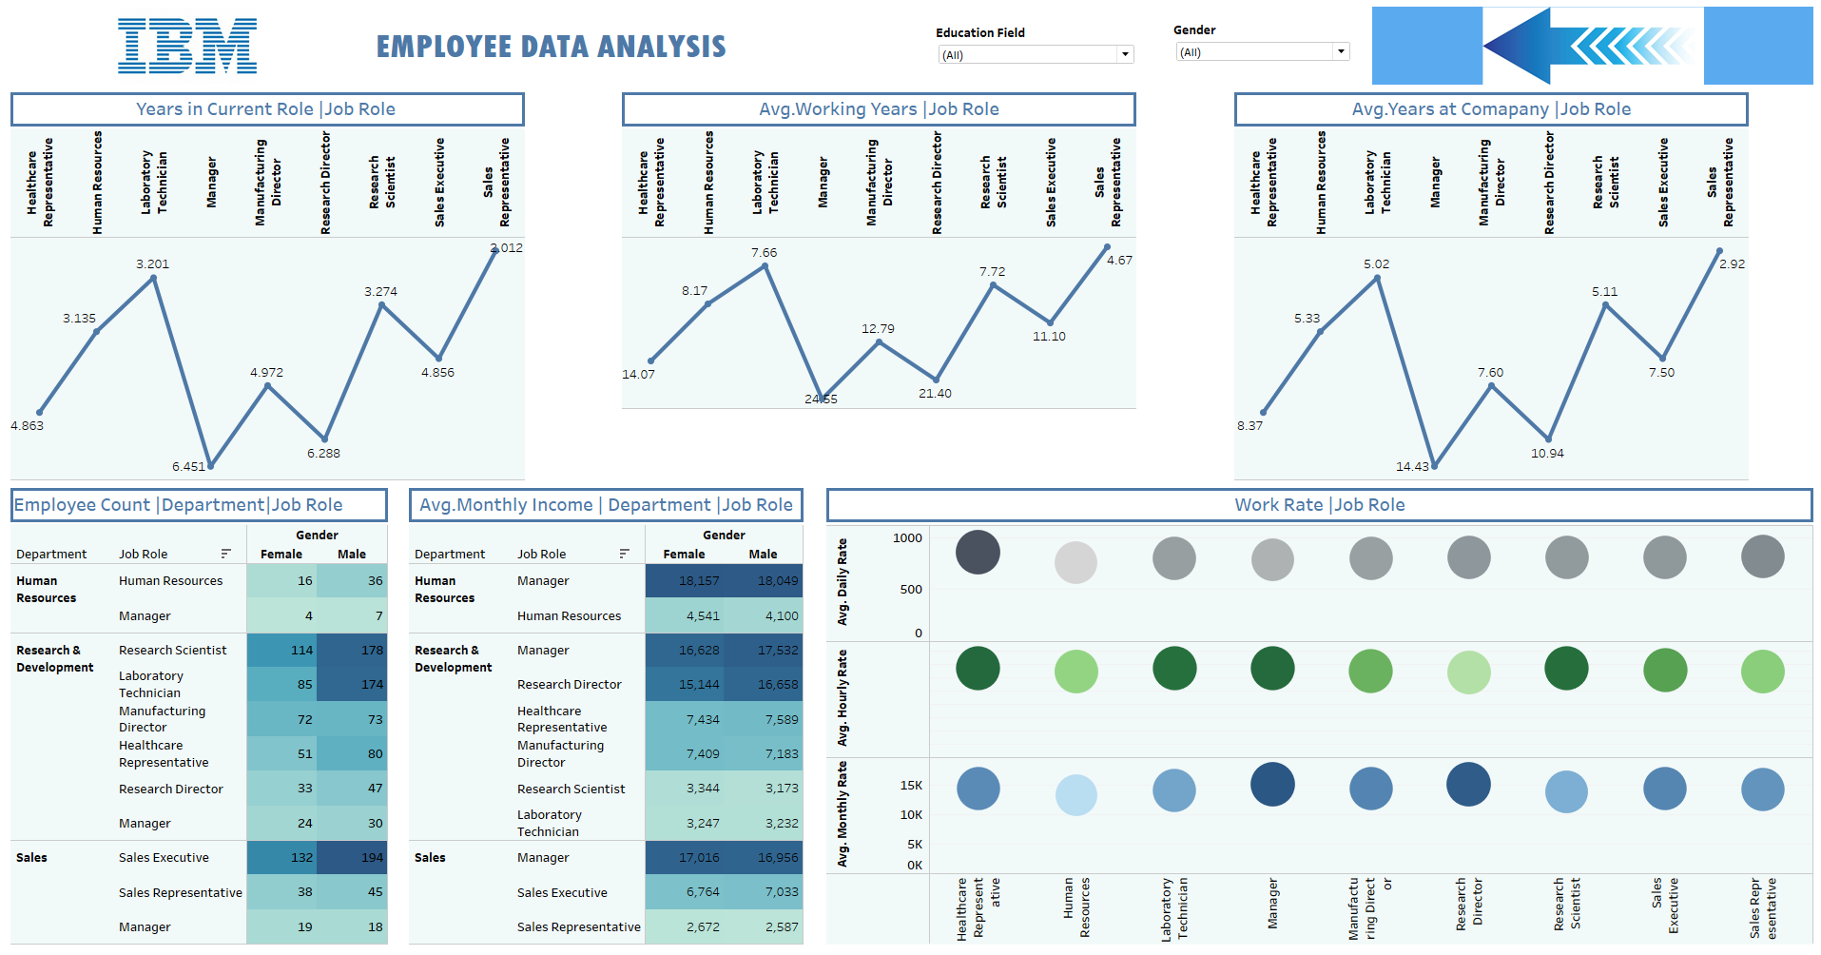
COMPLETE DASHBOARD
IBM EMPLOYEE ANALYSIS -2

Slide 15
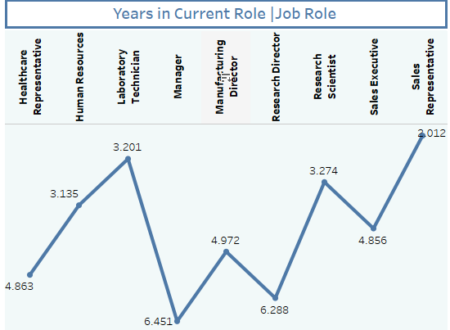
YEARS IN CURRENT ROLE | JOB ROLE
Shows: Average tenure of employees in their current roles (e.g., Laboratory Technicians: 6.45 years, Sales Executives: 3.01 years).
Purpose: Highlights retention and potential stagnation in specific roles.
Why Line Chart:
Ideal for comparing trends across job roles.
4. Questions Answered:
Are employees staying in roles too long without
promotions?
Which roles experience the shortest retention periods?

Slide 16
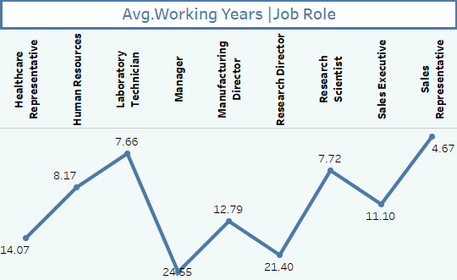
AVG. WORKING YEARS | JOB ROLE
Shows: Average total working experience of employees in various roles (e.g., Manufacturing Directors: 21.4 years).
Purpose: Reveals the level of experience in each job role.
Why Line Chart:
Effectively illustrates variation in experience across
job categories.
4. Questions Answered:
Are experienced employees concentrated in
leadership roles?
Is there a lack of seasoned talent in any roles?

Slide 17
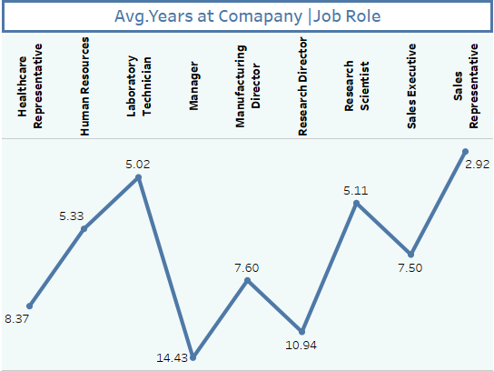
AVG. YEARS AT COMAPNY
Shows: Average tenure at the company by job role (e.g., Managers: 7.6 years, Laboratory Technicians: 14.4 years).
Purpose: Identifies roles with high loyalty or high turnover.
Why Line Chart:
Clearly compares tenure trends across roles.
4. Questions Answered:
Which roles foster the longest employee loyalty?
Are certain roles prone to early attrition?

Slide 18
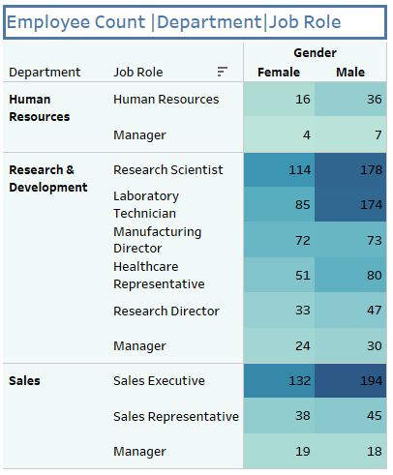
DEPARTMENT | EMPLOYEE COUNT
Shows: Workforce distribution across departments and genders.
Purpose: Evaluates diversity and staffing.
Key Insight: R&D has a gender disparity, with males dominating technical roles.

Slide 19
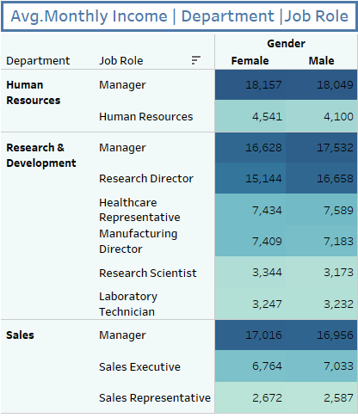
DEPARTMENT | AVG. MONTHLY INCOME
Shows: Income trends across roles (e.g., Research Directors are highest paid).
Purpose: Assesses pay equity.
Key Insight: Significant salary variations exist between roles.

Slide 20
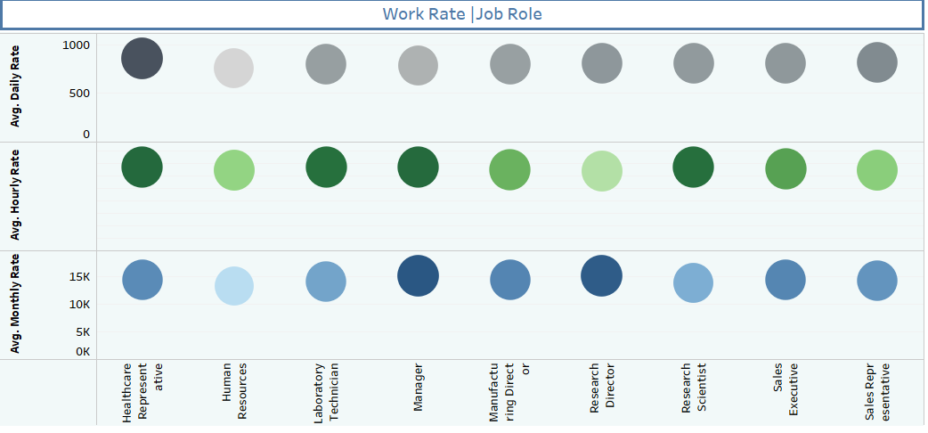
WORK RATE BY ROLE
Shows: Daily, hourly, and monthly rates for each job role, represented as bubbles of varying sizes.
Purpose: Provides a comparative view of pay rates by job role, helping assess the value of roles within the organization.
Why Bubble Chart:
Allows simultaneous comparison of multiple metrics (e.g.,
daily, hourly, and monthly rates) for different job roles.
4. Business Questions Solved:
Which roles contribute the most value in terms of pay rates?
Are pay rates proportional to experience or job demands?

Slide 21
INSIGHTS
Retention Patterns:
Roles like Laboratory Technicians and Research Scientists exhibit longer retention, suggesting satisfaction or limited career progression.
Lower tenure for roles like Sales Representatives may indicate high turnover rates.
Workforce Allocation:
R&D dominates the workforce with a significant gender disparity in technical roles.
Sales Executives show a balanced gender distribution but face shorter tenure on average.
Compensation Trends:
High-paying roles like Research Directors and Manufacturing Directors align with their high experience levels.
Pay disparities could be addressed in roles with similar requirements but lower compensation.
Diversity:
Gender imbalance exists in leadership roles, with fewer females occupying managerial positions.
Departments like Sales show better gender parity compared to R&D.
Experience Levels:
Roles requiring high expertise, like Research Directors, attract experienced professionals with longer working years.

Slide 22
THANK YOU

